Slide 1
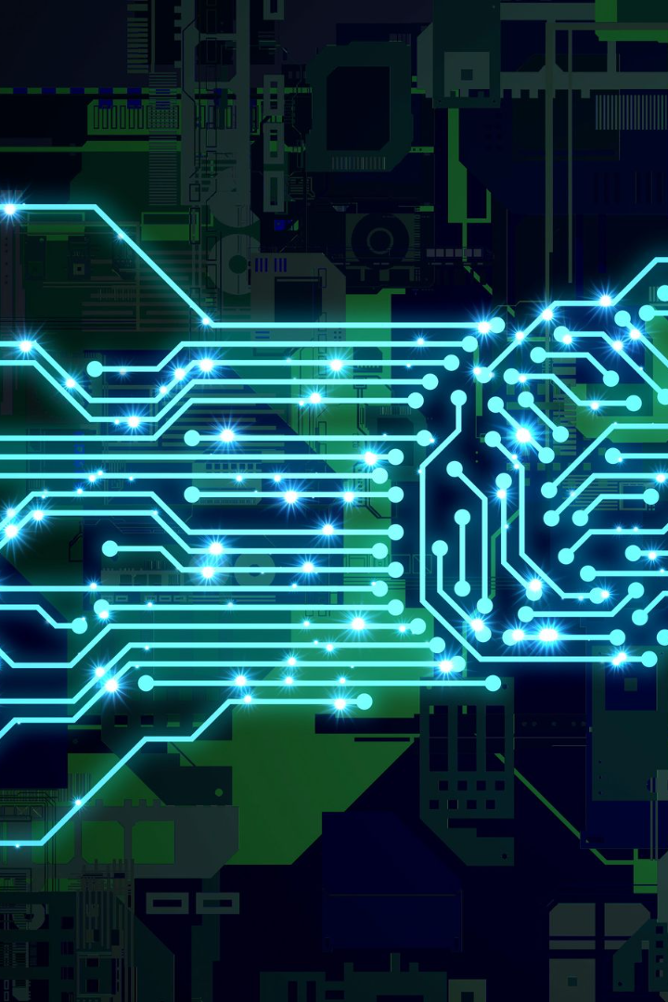


Intelligent Systems in AI
Artificial intelligence is changing the world. In this presentation, we'll explore how intelligent systems enhance these changes, the challenges and benefits in using them, and their future applications in various industries.
by sawan kumar

Slide 2
Introduction to Intelligent Systems in AI
Intelligent systems, also known as cognitive computing, refers to an AI system equipped with advanced machine learning and reasoning abilities. These systems can understand, connect, and learn from data to automate a wide range of tasks, from detecting fraud to predicting future events.

Slide 3
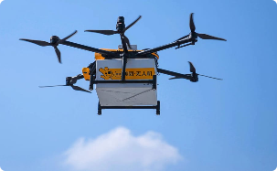
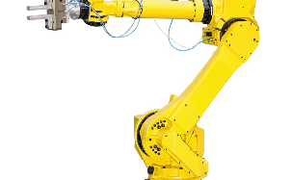


Applications of Intelligent Systems in AI
Transportation
Manufacturing
Healthcare
Self-driving cars and drones equipped with AI systems can help reduce traffic congestion, optimize delivery routes, and improve public safety.
With the help of intelligent systems, robots can take on complex tasks such as quality checks, assembly, and material handling, thus optimizing production and lowering costs.
Intelligent systems in healthcare can assist in the diagnosis of diseases, development of treatment plans, and management of patient data, improving patient outcomes and reducing costs.
Finance
Intelligent systems can analyze large amounts of financial data to identify trends, risks, and opportunities, providing insights to clients and supporting financial decision-making processes.

Slide 4
Types of Intelligent Systems in AI
Expert Systems
Neural Networks
Used in engineering, medicine, and other fields, they mimic the decision-making abilities of a human expert.
Used in image and speech recognition, they simulate the workings of the human brain to identify patterns and classify data.
Fuzzy Logic Systems
Genetic Algorithms
Used in control systems and decision-making, they can work with incomplete or uncertain data, making them ideal for complex scenarios.
Used in optimization problems, they mimic natural selection to find solutions that meet specific criteria, evolving over time.

Slide 5
Advantages of Using Intelligent Systems in AI
1
Increased Efficiency
Intelligent systems can process data and automate tasks faster and more accurately than humans, allowing organizations to save time and money.
Better Decision-Making
2
Intelligent systems can analyze vast amounts of complex data and provide insights that humans may not be able to see, supporting informed decision-making processes.
3
Improved Customer Experience
Intelligent systems can personalize and enhance customer interactions, providing better service and building customer loyalty.

Slide 6

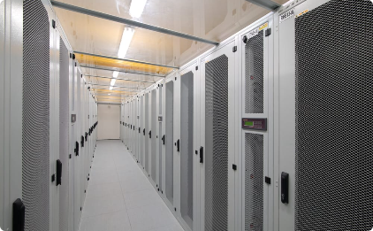
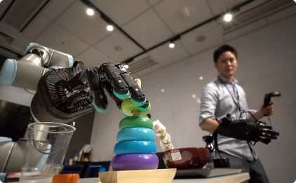
Challenges of Using Intelligent Systems in AI
Regulation
Data Management
Workforce Displacement
Ethical and legal considerations surrounding intelligent systems, including accountability, transparency, and bias, must be addressed to ensure the development and deployment of safe and fair systems.
Intelligent systems require vast amounts of data to learn, but managing and processing this data requires significant resources, specialized skills, and secure infrastructure.
The use of intelligent systems may lead to the displacement of human workers, requiring organizations to consider equitable workforce planning and training.

Slide 7
Ethical Considerations in the Development and Use of Intelligent Systems in AI
Accountability
Transparency
Bias Mitigation
Intelligent systems must be designed to be accountable, ensuring that all decisions and actions are traceable and auditable.
Intelligent systems must be transparent, providing explanations and justifications for their decisions and actions.
Intelligent systems must be trained to avoid bias and unfairness, ensuring fair and equitable decision-making.

Slide 8

Future of Intelligent Systems in AI
The use of intelligent systems in AI is poised to have a significant impact on various industries, from transportation to healthcare to finance. As technology advances and becomes more accessible, we can expect to see more sophisticated systems that can tackle even more complex problems.

